Slide 1
The incidence & outcome of urethro-cutaneous fistula after hypospadias repair: Self-experience
Murtadha Almusafer
Professor & Consultant of Urology, University of Basrah, College of Medicine, Basrah, Iraq
E-mail: murtadha.majeed@uobasrah.edu.iq

Slide 2


شناشيل البصرة – الجسر الايطالي

Slide 3
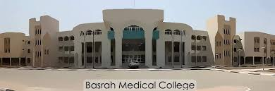


Slide 4
Why This study?
Hypospadias surgery has many complications
To shed light on how to deal with one of important complication which has an impact on urologist & family which is Urethro-Cutaneous Fistula (UCF) and to share our experience in this issue.

Slide 5
Who Should Operate ?????
Pediatric Urologist
Urologist
Plastic Surgeon
Pediatric Surgeon
Hypospadiologist

Slide 6
Background
In the United States, hypospadias occurs in 1 of every 200 to 300 live births.¹ The prevalence of hypospadias in Europe is approximately 18.6 of every 10000 live births, making it one of the most prevalent congenital defects among male newborns.²
1.Keays MA, Dave S. Current hypospadias management: diagnosis, surgical management, and long-term patient-centred outcomes. Can Urol Assoc J. 2017;11(1–2):48–53. doi:10.5489/cuaj.4386
2.van der H, de Wall LL. Hypospadias, all there is to know. Eur J Pediatr. 2017;176(4):435–441. doi:10.1007/s00431-017-2864-5

Slide 7
Many complications were recognized after hypospadias repair, UCF being among the most common ones.
It has been found to be associated with
- Type of surgery,
- Location of meatus, and
- Surgeon’s experience

Slide 8
objectives
To find out the incidence of UCF in Basrah Urology Center.
To classify the patients according to fistula characters and urethral status
To choose appropriate surgical technique

Slide 9
Methods
A total of 204 children
Duration: 2013 – 2023
Children with mid-shaft and distal hypospadias
The patients were classified according to the:
Site, size of fistula, and distal urethral patency

Slide 10
A trap door procedure and tubularized incised plate (TIP) were
the procedures used.
Children with small fistulae were treated initially conservatively.
Those with normal distal urethral patency: Classical fistula repair
Those with jeopardized distal urethral patency: Re-do TIP

Slide 11
Results
The mean age is 2.5-Years
A total of 204 children:
110 (53.9): Distal hypospadias
94 (46.07): Mid-shaft hypospadias

Slide 12
8 children (3.9%): UCF after hypospadias repair by TIP
1 child had original distal hypospadias repair
7 Children had original mid-shaft repair
Two Fistulae were so small with no distal urethral obstruction and closed spontaneously
The remaining 6 required surgical repair

Slide 13
The recurrence rate after surgical repair of fistula was 33.3% ( 2 out of 6 patients)

Slide 14
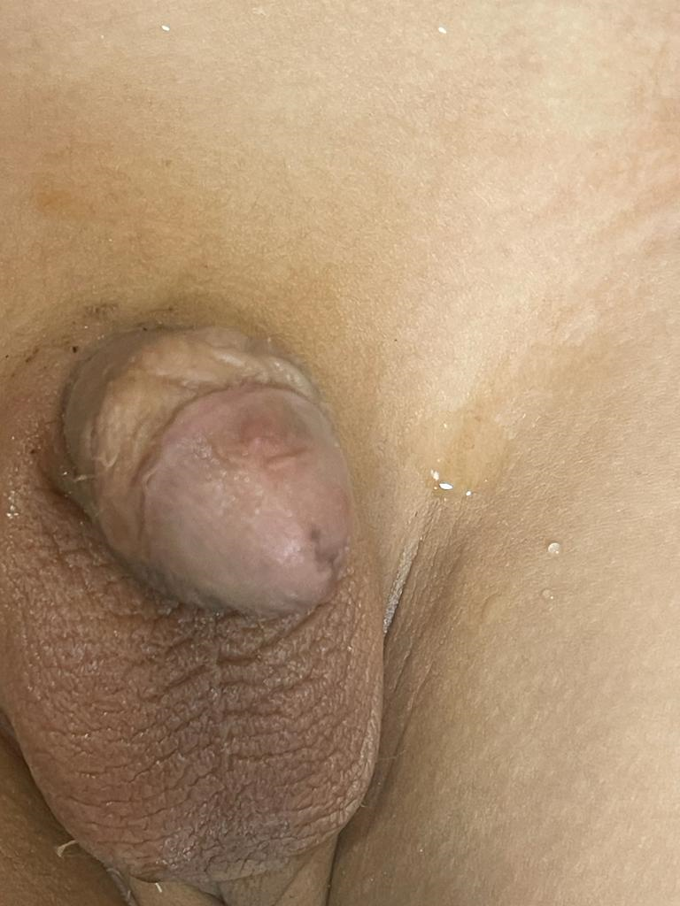
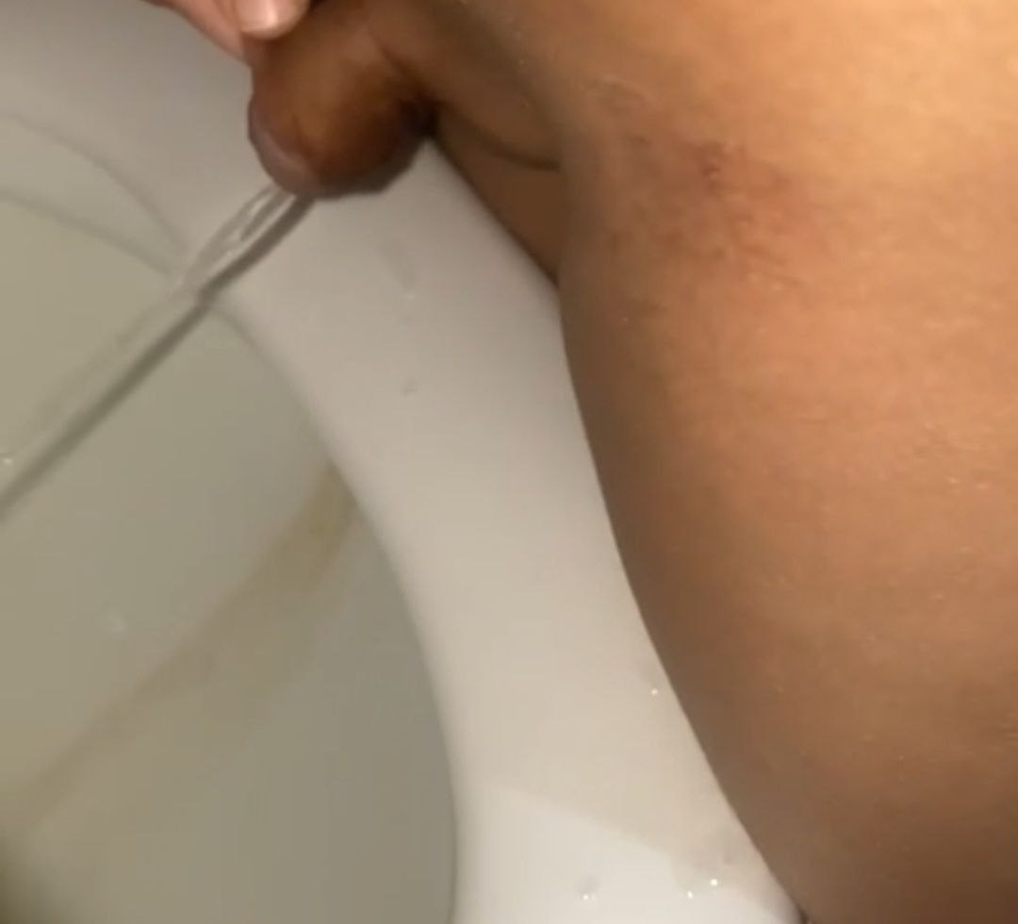
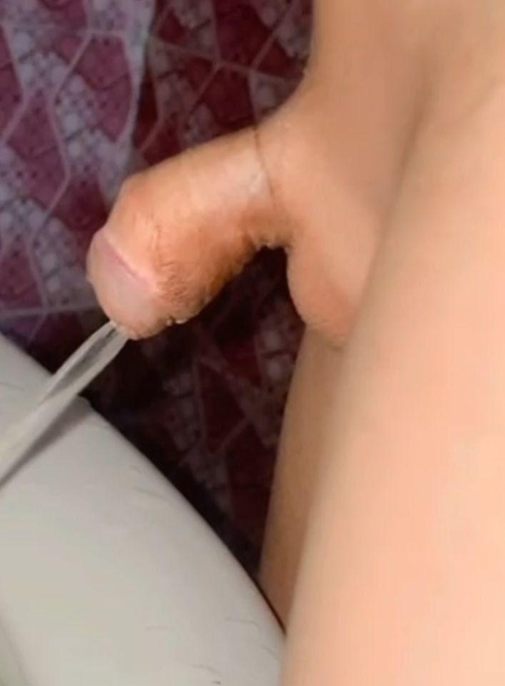
Final shape of penis and urine stream

Slide 15
Discussion
Despite progressive development in the surgical techniques and procedures, still many complications occurred, among the most common is UCF
Different literatures reported different incidence rates of UCF
Gabra, Beyari, et al (Saudi Arabia): Urethral fistula was the most common complication among distal and proximal cases (24% and 30%, respectively)

Slide 16
Yuhao Wu, Junke Wang, et al (China): included 44 studies involving 10,666 subjects. Urethrocutaneous fistula (UCF) was the most common complication with an incidence of 4.0%
This is in consistent with our results

Slide 17
Tihitena Negussie Mammo, Samuel A Negash, et al (Ethiopia):
There was a high rate of major post-operative complications (44.1%) of which urethrocutaneous fistula (UCF) was the most common (31.2%) followed by meatal stenosis and glans breakdown (7.4 % each).

Slide 18
Recommendations
Snodgrass et al: Simple UCF repair for coronal site without glans dehiscence achieved satisfactory outcomes, and the recurrence rate was only 5% which is lower than our results (33.3%)

Slide 19
Conclusion
Fistula characteristics should be well evaluated
Distal urethral patency shoul be assessed
Surgeon’s experience
Family education and child care

